Slide 1
Microsoft Azure: Introduction to Cloud Business Analytics
Module: Azure Cloud Concepts and Tools

Slide 2
Introduction to Azure Cloud Concepts and Tools

Slide 4
Introduction and logistics
Your trainer
You
Start and end times
Lunch and breaks

Slide 5
Logistics –Azure Subscription SignUp
First, you need a Microsoft Account (any email address that is registered as a Microsoft Account)
If you have one, confirm by logging to https://login.live.com
If you don’t, create one at https://signup.live.com
Once you have the account ready, go to https://microsoftazurepass.com and click on Start

Slide 6
Where Is The Content For This Workshop?
https://github.com/pferahul/ICBA112017
Great! But I only see xx modules here. Where is the rest of the content?
It’s being updated! You will see new content every day!

Slide 7
What is Microsoft Azure?
Microsoft Azure is Microsoft’s public cloud computing platform
Over 100 datacenters across 30 regions worldwide
Hyper Scale Computing
Top 3 networks worldwide
Microsoft Confidential
Notes:
What is Microsoft Azure? Microsoft Azure is Microsoft's public cloud computing platform and infrastructure for building, deploying, and managing applications and services through a global network of Microsoft-managed datacenters. It provides both PaaS and IaaS services and supports many different programming languages, tools and frameworks, including both Microsoft-specific and third-party software and systems. It consists of over 100 datacenters across 30 regions worldwide. It provides hyper scale computing capabilities and makes up the top 3 networks in the world. To give you an idea of its hyperscale computing power, it is able to host the largest virtual machine in the world with a configuration of 32 cores 448GB RAM and fast solid state disk.

Slide 8
Benefits of Cloud Computing
On and Off
Inactivity
Period
On and off workloads (e.g. batch job)
Over provisioned capacity is wasted
Time to market can be cumbersome
Compute
t
Growing Fast
Compute
Successful services needs to grow/scale
Keeping up with growth is a big IT challenge
Cannot provision hardware fast enough
t
Unpredictable Bursting
Compute
Unexpected/unplanned peak in demand
Sudden spike impacts performance
Cannot over provision for extreme cases
t
Predictable Bursting
Compute
Services with micro seasonality trends
Peaks due to periodic increased demand
IT complexity and wasted capacity
t
Microsoft Confidential
Notes:
More on the benefits of cloud computing, on and off workloads for example batch jobs, which during periods of inactivity have their over provisioned capacities wasted.
Growing fast. Applications and services are growing fast and keeping up with provisioning hardware is a challenge.
Unpredictable bursting. For example unexpected or unplanned peaks in demand directly impacts server performance. it is also difficult to over provision for extreme cases due to resource limitations.
Predictable bursting. For example applications or services with seasonal trends that peak due to periodic increased demand. they commonly have a complex infrastructure to implement and often over provisioning means wasted capacity
These are some of the areas in which cloud computing could be beneficial to your organisation.
The cloud computing patterns about why someone would want to shift from on-premises solutions into Microsoft Azure are self-explanatory. Have customers think about the applications that they currently have, to determine if they fit into this picture.
Understand, though, that just because a customer wants elasticity, it does not mean that their app is built for it.

Slide 9

Pizza as a Service
Notes:
The idea is to ask the attendees what they need to make a pizza. Use the whiteboard to note down their ideas.
You can make a pizza at home where you’re responsible for buying all of the ingredients including making the dough.
You can purchase some of the ingredients and buy pre-packaged dough.
You can have pizza delivered to your home.
You can simply load up the family and head out for pizza at your local dining establishment.
In each case you’re still having pizza however in some cases you do all of the work and others you have other people do the work for you.

Slide 10
Pizza as a Service
Traditional On-Premises (On-Prem)
Infrastructure as a Service (IaaS)
Platform as a Service (PaaS)
Software as a Service (SaaS)
You Manage
Dining Table
Dining Table
Dining Table
Dining Table
Vendor Manages
Soda
Soda
Soda
Soda
Electric/Gas
Electric/Gas
Electric/Gas
Electric/Gas
Oven
Oven
Oven
Oven
Fire
Fire
Fire
Fire
Pizza Dough
Pizza Dough
Pizza Dough
Pizza Dough
Tomato Sauce
Tomato Sauce
Tomato Sauce
Tomato Sauce
Toppings
Toppings
Toppings
Toppings
Cheese
Cheese
Cheese
Cheese
Made at Home
Take and Bake
Pizza Delivered
Dine Out
Microsoft Confidential
Notes:
The Azure Pizza Analogy
Breaking down how traditional environments, IaaS, PaaS, and SaaS compare to different types of pizza delivery and pizza businesses can help us understand what we get out of each type of service and who is responsible for the different components.
Traditional Environments (Make Your Pizza at Home) – You are responsible for everything. You need a place to fully cook the pizza. You need all of the ingredients including a place where the pizza is going to be served. You need your own pizza oven. The time and work going into all aspects of putting the sauce together, cutting up the vegetables, pepperoni, and other toppings is your responsibility. If you are going to take this on you are likely going to need a full staff to man each station and people to maintain and clean the equipment and the kitchen / restaurant. If you aren’t opening up your own pizza business this would be an extremely high cost. You can try and make it cheaper by using a cheaper over, cheaper ingredients, and cutting corners here and there, but the model in and of itself has a high price in its design.
Infrastructure as a Service (IaaS) – You are responsible for some of the effort, but not all of it. You need to cook the pizza in a basic oven, supply anything to drink, and a place to eat the pizza.. But this has no where near the overhead of running your own pizza restaurant. Just go to the grocery and pizza up a frozen pizza. You can pick an expensive one put together with fresh ingredients from the deli.. Maybe with dough made onsite or you can get a cheaper one from the store in the freezer section.
Platform as a Service (PaaS) – You need a place to eat the pizza and maybe something to go along with it like a salad or something to drink, but that is about it. The pizza delivery company takes care of everything else. Again, you can control the cost. You can get fast and cheap, or go with a local specialty restaurant that is more expensive with much better quality.
Software as a Service (SaaS) – This is the opposite of the traditional environment. The restaurant does everything. Just show up with shirt, shoes, and money and you can sit down and enjoy your pizza with a menu and options. You don’t need to bring a place to sit, drinks, salad, anything but yourself. The restaurant does it all.
Reference: http://blogs.technet.com/b/daven/archive/2014/08/05/pizza-as-a-service.aspx

Slide 11
Overview of Cloud Services
On Premises
Infrastructure
as a Service (IaaS)
Platform
as a Service (PaaS) (IaaS)
Software
as a Service (SaaS))
Applications
Applications
Customer
Applications
Applications
Data
Data
Data
Data
Customer
Runtime
Runtime
Runtime
Runtime
Managed by Microsoft
Middleware
Middleware
Middleware
Managed by Microsoft
Middleware
Customer
O/S
O/S
O/S
O/S
Managed by Microsoft
Virtualization
Virtualization
Virtualization
Virtualization
Servers
Servers
Servers
Servers
Storage
Storage
Storage
Storage
Networking
Networking
Networking
Networking
Notes:
IaaS
With Infrastructure as a Service, the lower levels of the stack are managed by a vendor. Some of these components can be provided by traditional hosters – in fact most of them have moved to having a virtualized offering.
Very few actually provide an OS
The customer is still responsible for managing the OS through the Applications.
For the developer, an obvious benefit with IaaS is that it frees the developer from many concerns when provisioning physical or virtual machines.
This was one of the earliest and primary use cases for Amazon Web Services Elastic Cloud Compute (EC2).
Developers were able to readily provision virtual machines (AMIs) on EC2, develop and test solutions and, often, run the results ‘in production’.
The only requirement was a credit card to pay for the services.
PaaS
With Platform as a Service, everything from the network connectivity through the runtime is provided and managed by the platform vendor.
The Windows Azure best fits in this category today.
In fact because we don’t provide access to the underlying virtualization or operating system today, we’re often referred to as not providing IaaS.
PaaS offerings further reduce the developer burden by additionally supporting the platform runtime and related application services.
With PaaS, the developer can, almost immediately, begin creating the business logic for an application.
Potentially, the increases in productivity are considerable and, because the hardware and operational aspects of the cloud platform are also managed by the cloud platform provider, applications can quickly be taken from an idea to reality very quickly.
SaaS
Finally, with SaaS, a vendor provides the application and abstracts you from all of the underlying components.

Slide 12
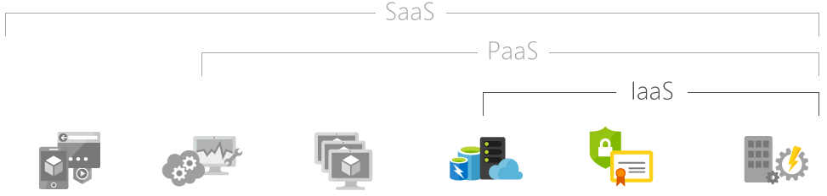
What is IaaS?
Rent IT infrastructure (servers and virtual machines (VMs), storage, networks, operating systems) from a cloud provider on a pay-as-you-go basis
Hosted apps / applications
Development tools, database management, business analytics
Operating systems
Servers and storage
Networking firewalls / security
Data center physical plant / building
Notes:
The most basic category of cloud computing services. With IaaS, you rent IT infrastructure—servers and virtual machines (VMs), storage, networks, operating systems—from a cloud provider on a pay-as-you-go basis.
Infrastructure as a service (IaaS) is an instant computing infrastructure, provisioned and managed over the Internet. Quickly scale up and down with demand, and pay only for what you use.
IaaS helps you avoid the expense and complexity of buying and managing your own physical servers and other datacenter infrastructure. Each resource is offered as a separate service component, and you only need to rent a particular one for as long as you need it. The cloud computing service provider manages the infrastructure, while you purchase, install, configure, and manage your own software—operating systems, middleware, and applications.
Common IaaS business scenarios
Typical things businesses do with IaaS include:
Test and development. Teams can quickly set up and dismantle test and development environments, bringing new applications to market faster. IaaS makes it quick and economical to scale up dev-test environments up and down.
Website hosting. Running websites using IaaS can be less expensive than traditional web hosting.
Storage, backup, and recovery. Organizations avoid the capital outlay for storage and complexity of storage management, which typically requires a skilled staff to manage data and meet legal and compliance requirements. IaaS is useful for handling unpredictable demand and steadily growing storage needs. It can also simplify planning and management of backup and recovery systems.
Web apps. IaaS provides all the infrastructure to support web apps, including storage, web and application servers, and networking resources. Organizations can quickly deploy web apps on IaaS and easily scale infrastructure up and down when demand for the apps is unpredictable.
High-performance computing. High-performance computing (HPC) on supercomputers, computer grids, or computer clusters helps solve complex problems involving millions of variables or calculations. Examples include earthquake and protein folding simulations, climate and weather predictions, financial modeling, and evaluating product designs.
Big data analysis. Big data is a popular term for massive data sets that contain potentially valuable patterns, trends, and associations. Mining data sets to locate or tease out these hidden patterns requires a huge amount of processing power, which IaaS economically provides.
Advantages of IaaS
Eliminates capital expense and reduces ongoing cost. IaaS sidesteps the upfront expense of setting up and managing an on-site datacenter, making it an economical option for start-ups and businesses testing new ideas.
Improves business continuity and disaster recovery. Achieving high availability, business continuity, and disaster recovery is expensive, since it requires a significant amount of technology and staff. But with the right service level agreement (SLA) in place, IaaS can reduce this cost and access applications and data as usual during a disaster or outage.
Innovate rapidly. As soon as you’ve decided to launch a new product or initiative, the necessary computing infrastructure can be ready in minutes or hours, rather than the days or weeks—and sometimes months—it could take to set up internally.
Respond quicker to shifting business conditions. IaaS enables you to quickly scale up resources to accommodate spikes in demand for your application— during the holidays, for example—then scale resources back down again when activity decreases to save money.
Focus on your core business. IaaS frees up your team to focus on your organization’s core business rather than on IT infrastructure.
Increase stability, reliability, and supportability. With IaaS there’s no need to maintain and upgrade software and hardware or troubleshoot equipment problems. With the appropriate agreement in place, the service provider assures that your infrastructure is reliable and meets SLAs.
Better security. With the appropriate service agreement, a cloud service provider can provide security for your applications and data that may be better than what you can attain in-house.
Gets new apps to users faster. Because you don’t need to first set up the infrastructure before you can develop and deliver apps, you can get them to users faster with IaaS.
https://azure.microsoft.com/en-us/overview/what-is-iaas/

Slide 13
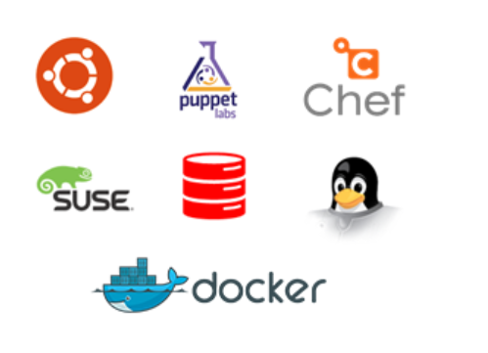
Overview of IaaS
Compute, Storage and Network, provisioned and managed over the Internet
Quickly scale up and down with demand
Windows Server and Linux VMs
Built-in Virtual Networking, Load Balancing
Hybrid with On-Premises
Open Source Images software and solutions
Under Azure Resource Manager
Notes:
Infrastructure as Service (IaaS)
IaaS is fundamentally on-demand computing and storage to host, scale, and manage applications and services. By pooling computing and storage resources it is possible to scale with ease and speed to meet the infrastructure needs of the entire organization or individual departments, globally or locally.
Open Source
Full range of open and community-driven OS and software solutions available on Azure. Full range of Linux distributions like Ubuntu and SUSE, community-driven solutions like Chef, Puppet, and Docker along with other products like Oracle Database and Oracle WebLogic Server.
VM Resource Manager
The inclusion of Compute, Network & Storage capabilities with the Azure Resource Manager will fundamentally simplify the deployment and management of complex applications running on IaaS. Many applications require a combination of resources, including a Virtual Network, Storage Account, Virtual Machine, and a Network Interface. The Azure Resource Manager offers the ability to construct a JSON template to deploy and manage all these resources together as a single application.

Slide 14
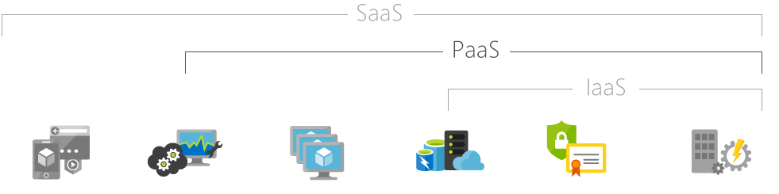
What is PaaS?
Cloud computing services that supply an on-demand environment for developing, testing, delivering, and managing software applications.
Hosted apps / applications
Development tools, database management, business analytics
Operating systems
Servers and storage
Networking firewalls / security
Data center physical plant / building
Notes:
Platform-as-a-service (PaaS) refers to cloud computing services that supply an on-demand environment for developing, testing, delivering, and managing software applications. PaaS is designed to make it easier for developers to quickly create web or mobile apps, without worrying about setting up or managing the underlying infrastructure of servers, storage, network, and databases needed for development.
Platform as a service (PaaS) is a complete development and deployment environment in the cloud, with resources that enable you to deliver everything from simple cloud-based apps to sophisticated, cloud-enabled enterprise applications. You purchase the resources you need from a cloud service provider on a pay-as-you-go basis and access them over a secure Internet connection.
Like IaaS, PaaS includes infrastructure—servers, storage, and networking—but also middleware, development tools, business intelligence (BI) services, database management systems, and more. PaaS is designed to support the complete web application lifecycle: building, testing, deploying, managing, and updating.
PaaS allows you to avoid the expense and complexity of buying and managing software licenses, the underlying application infrastructure and middleware or the development tools and other resources. You manage the applications and services you develop, and the cloud service provider typically manages everything else.
Common PaaS scenarios
Organizations typically use PaaS for these scenarios:
Development framework. PaaS provides a framework that developers can build upon to develop or customize cloud-based applications. Similar to the way you create an Excel macro, PaaS lets developers create applications using built-in software components. Cloud features such as scalability, high-availability, and multi-tenant capability are included, reducing the amount of coding that developers must do.
Analytics or business intelligence. Tools provided as a service with PaaS allow organizations to analyze and mine their data, finding insights and patterns and predicting outcomes to improve forecasting, product design decisions, investment returns, and other business decisions.
Additional services. PaaS providers may offer other services that enhance applications, such as workflow, directory, security, and scheduling.
Advantages of PaaS
By delivering infrastructure as a service, PaaS offers the same advantages as IaaS. But its additional features—middleware, development tools, and other business tools—give you more advantages:
Cut coding time. PaaS development tools can cut the time it takes to code new apps with pre-coded application components built into the platform, such as workflow, directory services, security features, search, and so on.
Add development capabilities without adding staff. Platform as a Service components can give your development team new capabilities without your needing to add staff having the required skills.
Develop for multiple platforms—including mobile—more easily. Some service providers give you development options for multiple platforms, such as computers, mobile devices, and browsers making cross-platform apps quicker and easier to develop.
Use sophisticated tools affordably. A pay-as-you-go model makes it possible for individuals or organizations to use sophisticated development software and business intelligence and analytics tools that they could not afford to purchase outright.
Support geographically distributed development teams. Because the development environment is accessed over the Internet, development teams can work together on projects even when team members are in remote locations.
Efficiently manage the application lifecycle. PaaS provides all of the capabilities that you need to support the complete web application lifecycle: building, testing, deploying, managing, and updating within the same integrated environment.
https://azure.microsoft.com/en-us/overview/what-is-paas/

Slide 15
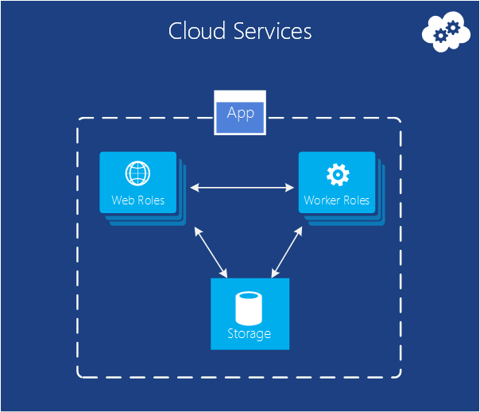
Overview of PaaS
Simplify deployment, configuration, and management
Integration with IaaS
Scalable, reliable and limited admin
SQL Database, SQL Data Warehouse, HDInsight, Azure Cosmos DB, App Services
Notes:
Platform as Service (Paas)
The Microsoft Azure platform provides a cloud services operating system and a set of services to support easy development and operation of applications for the platform. The platform provides functionality to build and manage applications that span from consumer Web to enterprise scenarios. No longer the need to spend hours managing VMs, patching Operating Systems and Frameworks.

Slide 16
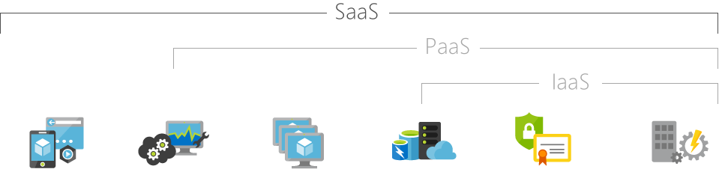
What is SaaS?
Software applications over the Internet, on demand and typically on a subscription basis.
Hosted apps / applications
Development tools, database management, business analytics
Operating systems
Servers and storage
Networking firewalls / security
Data center physical plant / building
Notes:
Software-as-a-service (SaaS) is a method for delivering software applications over the Internet, on demand and typically on a subscription basis. With SaaS, cloud providers host and manage the software application and underlying infrastructure, and handle any maintenance, like software upgrades and security patching. Users connect to the application over the Internet, usually with a web browser on their phone, tablet, or PC.
Software as a service (SaaS) allows users to connect to and use cloud-based apps over the Internet. Common examples are email, calendaring, and office tools (such as Microsoft Office 365).
SaaS provides a complete software solution that you purchase on a pay-as-you-go basis from a cloud service provider. You rent the use of an app for your organization, and your users connect to it over the Internet, usually with a web browser. All of the underlying infrastructure, middleware, app software, and app data are located in the service provider’s data center. The service provider manages the hardware and software, and with the appropriate service agreement, will ensure the availability and the security of the app and your data as well. SaaS allows your organization to get quickly up and running with an app at minimal upfront cost.
Common SaaS scenarios
If you’ve used a web-based email service such as Outlook, Hotmail, or Yahoo! Mail, then you’ve already used a form of SaaS. With these services, you log into your account over the Internet, often from a web browser. The email software is located on the service provider’s network, and your messages are stored there as well. You can access your email and stored messages from a web browser on any computer or Internet-connected device.
The previous examples are free services for personal use. For organizational use, you can rent productivity apps, such as email, collaboration, and calendaring; and sophisticated business applications such as customer relationship management (CRM), enterprise resource planning (ERP), and document management. You pay for the use of these apps by subscription or according to the level of use.
Advantages of SaaS
Gain access to sophisticated applications. To provide SaaS apps to users, you don’t need to purchase, install, update, or maintain any hardware, middleware, or software. SaaS makes even sophisticated enterprise applications, such as ERP and CRM, affordable for organizations that lack the resources to buy, deploy, and manage the required infrastructure and software themselves.
Pay only for what you use. You also save money because the SaaS service automatically scales up and down according to the level of usage.
Use free client software. Users can run most SaaS apps directly from their web browser without needing to download and install any software, although some apps require plugins. This means that you don’t need to purchase and install special software for your users.
Mobilize your workforce easily. SaaS makes it easy to “mobilize” your workforce because users can access SaaS apps and data from any Internet-connected computer or mobile device. You don’t need to worry about developing apps to run on different types of computers and devices because the service provider has already done so. In addition, you don’t need to bring special expertise onboard to manage the security issues inherent in mobile computing. A carefully chosen service provider will ensure the security of your data, regardless of the type of device consuming it.
Access app data from anywhere. With data stored in the cloud, users can access their information from any Internet-connected computer or mobile device. And when app data is stored in the cloud, no data is lost if a user’s computer or device fails.

Slide 17
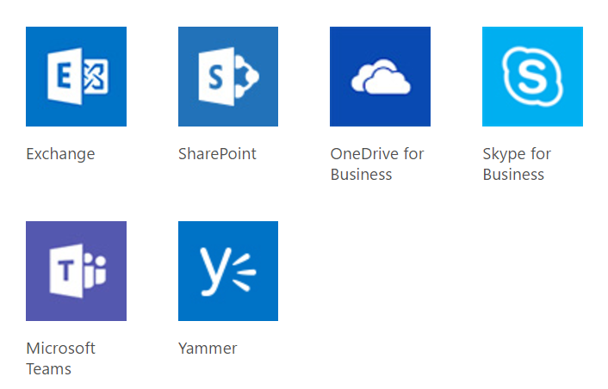
Examples of SaaS
Office 365
Skype
OneDrive
Power BI
Microsoft Teams
Visual Studio Team services
SharePoint Online
Dynamics 365
Notes:
Software as Service (Saas)
Software as a Service (SaaS) makes use of a cloud computing infrastructure to deliver one application to many users, regardless of their location, rather than the traditional model of one application per desktop. It allows activities to be managed from central locations in a one-to-many model, including architecture, pricing, partnering, and management characteristics.
Software as a Service (SaaS) has the potential to transform the way information-technology (IT) departments relate to and even think about their role as providers of computing services to the rest of the enterprise. The emergence of SaaS as an effective software-delivery mechanism creates an opportunity for IT departments to change their focus from deploying and supporting applications to managing the services that those applications provide. A successful service-centric IT, in turn, directly produces more value for the business by providing services that draw from both internal and external sources and align closely with business goals.

Slide 18



Advanced Analytics Life Cycle
Transform
Analyze
Catalog
Discover
{ }
Orchestrate
Store
Act
Ingest

Slide 19





Azure Advanced Analytics
Information Management
Big Data Stores
Machine Learning and Analytics
Dashboards and Visualizations
Business apps
Azure
Storage
Power BI
Azure
Machine Learning
Personal Digital Assistant
Azure
Data Factory
Azure
Data Lake
Cortana
People
Custom apps
Azure
HDInsight (Hadoop)
Perceptual Intelligence
Azure
Data Catalog
Azure
SQL Data Warehouse
Face, vision
Speech, text
Azure
Stream Analytics
Azure
Event Hub
Business Scenarios
Sensors and devices
Recommendations,
customer churn,
forecasting, etc.
Automated Systems
DATA
INTELLIGENCE
ACTION
Notes:
http://blogs.msdn.com/b/shanyu/archive/2015/09/18/understanding-and-using-hdinsight-spark-streaming.aspx

Slide 20
The Cortana Intelligence Platform
Big Data
Intelligence and Advanced Analytics
Information Management
Solutions
Visualization
Data Catalog
Data Factory
Event Hubs
Data Lake
SQL Data Warehouse
Cosmos DB
Cortana, Bot Service, Cognitive Framework
HDInsight
Data Lake
Azure Storage
Stream Analytics
Analysis Services
Power BI
R
Templates and Gallery
Machine Learning
Notes:
Azure Data Catalog - http://azure.microsoft.com/en-us/services/data-catalog (Doc It)
Azure Data Factory - http://azure.microsoft.com/en-us/services/data-factory/ (Move It)
Azure Event Hubs - http://azure.microsoft.com/en-us/services/event-hubs/ (Bring It)
Platform and Storage - Microsoft Azure – http://microsoftazure.com Storage - https://azure.microsoft.com/en-us/documentation/services/storage/ (Host It)
Azure Data Lake - http://azure.microsoft.com/en-us/campaigns/data-lake/ (Store It)
Azure SQL Data Warehouse - http://azure.microsoft.com/en-us/services/sql-data-warehouse/ (Relate It)
Azure Cosmos DB - https://docs.microsoft.com/en-us/azure/cosmos-db/introduction
Cortana - http://blogs.windows.com/buildingapps/2014/09/23/cortana-integration-and-speech-recognition-new-code-samples/ and https://blogs.windows.com/buildingapps/2015/08/25/using-cortana-to-interact-with-your-customers-10-by-10/ and https://developer.microsoft.com/en-us/Cortana (Say It)
Cognitive Services - https://www.microsoft.com/cognitive-services
Bot Framework - https://dev.botframework.com/
Azure Machine Learning - http://azure.microsoft.com/en-us/services/machine-learning/ (Learn It)
Azure HDInsight - http://azure.microsoft.com/en-us/services/hdinsight/ (Scale It)
Azure Stream Analytics - http://azure.microsoft.com/en-us/services/stream-analytics/ (Stream It)
Analysis Services - https://docs.microsoft.com/en-us/azure/analysis-services/analysis-services-overview
Power BI - https://powerbi.microsoft.com/ (See It)
All of the components within the suite - https://www.microsoft.com/en-us/server-cloud/cortana-intelligence-suite/what-is-cortana-intelligence.aspx
Templates - https://gallery.cortanaintelligence.com/browse?orderby=freshness%20desc&skip=0&categories=%5B%2210%22%5D and https://caqs.azure.net/#gallery

Slide 21
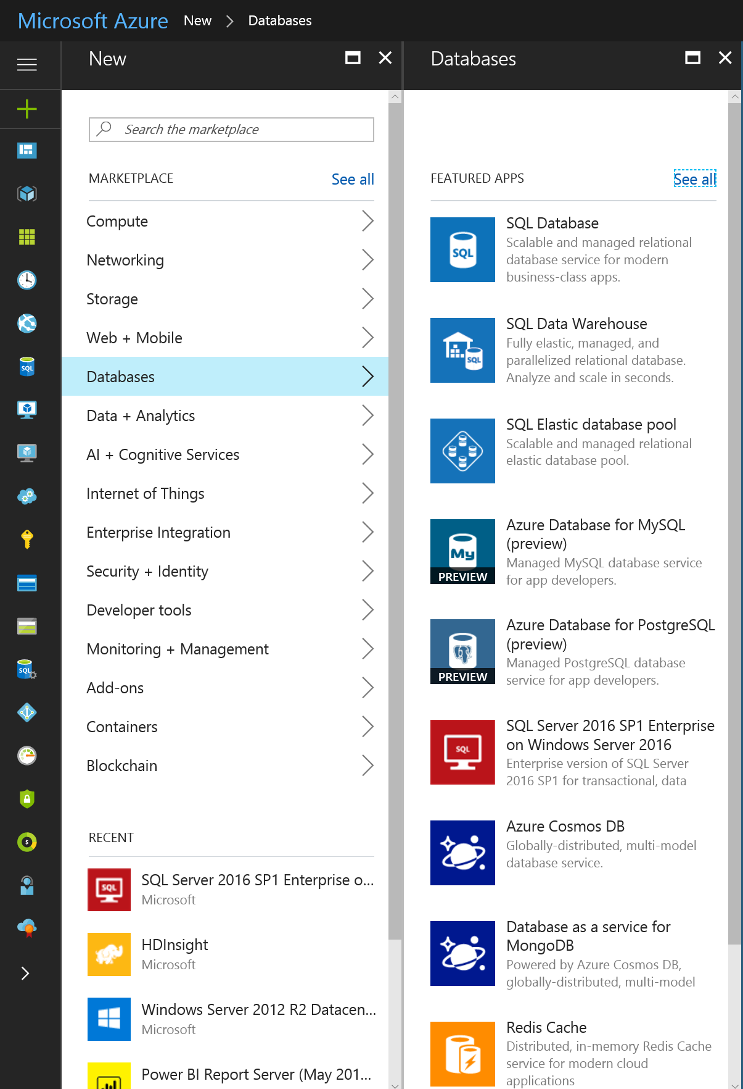
Overview of Cloud Analytics
Basic Services
Use Azure Data Factory to build pipelines and collect and orchestrate data from the services you use for easier analysis
Use Azure Data Catalog to effectively manage data sources
Store and manage structured data using Azure SQL Data Warehouse that elastically scales with massively parallel processing
Implement a hyper-scale repository with no file size limits for unstructured data using Azure Data Lake Store to attain massive throughput and analytic performance

Slide 22
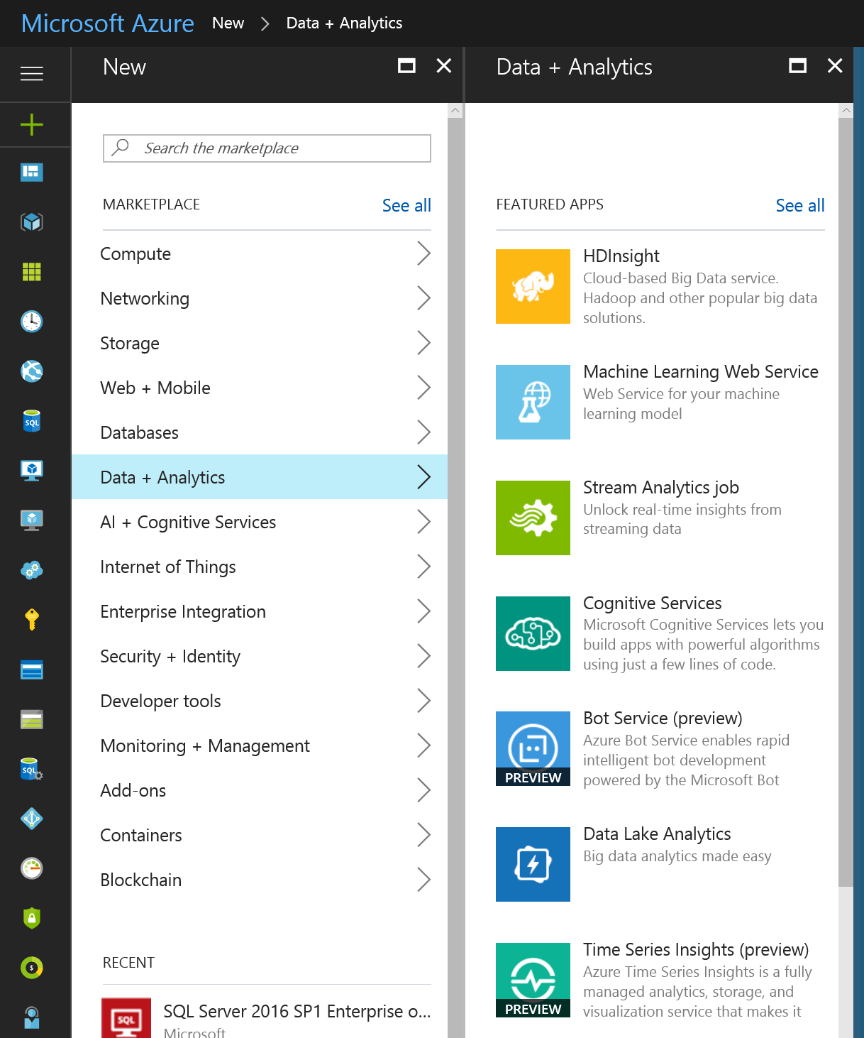
Overview of Cloud Analytics
Basic Services
Design and publish predictive models with Azure Machine Learning
Use Azure HDInsight to analyze data in Storm and Spark for Hadoop environments, integrate your code from R or Python
Analyze any kind or any size of data you need with Azure Data Lake Analytics

Slide 23
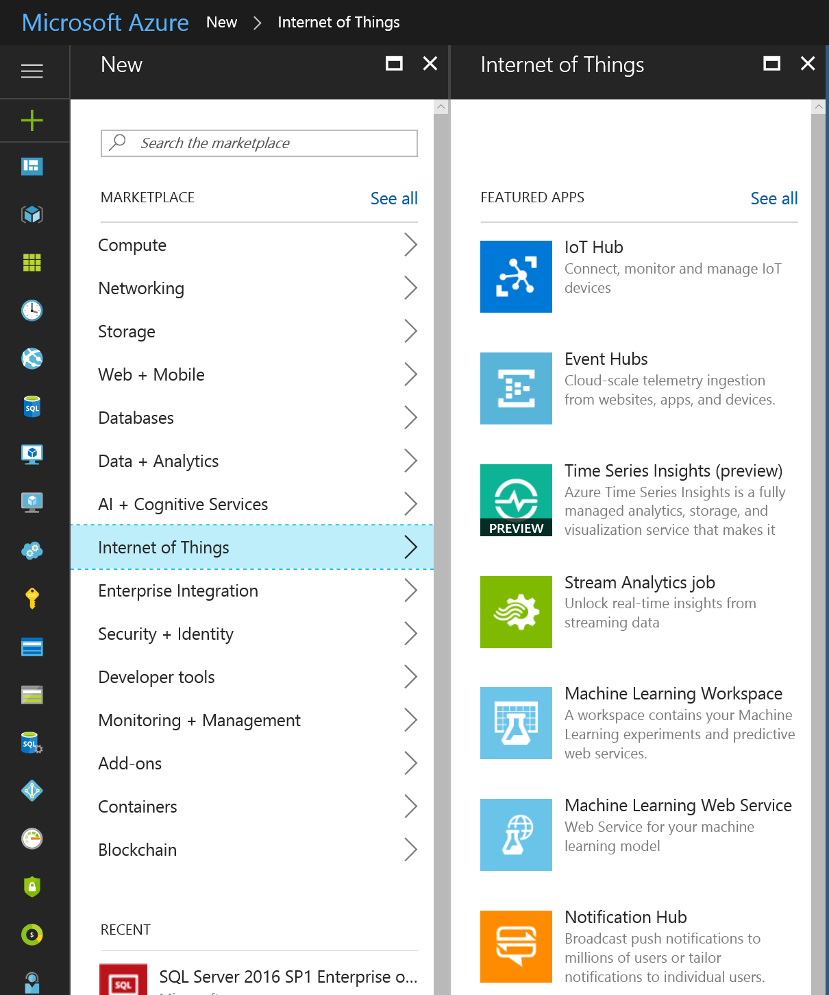
Overview of Cloud Analytics
Basic Services
Use Azure Event Hubs to provide a staging area for incoming streaming data.
Analyze any kind or any size of data you need with Azure Stream Analytics.
Use IoT Hub to connect, monitor and manage IoT Devices
Notes:
Event Hubs
Highly scalable publish-subscribe ingestor

Slide 24
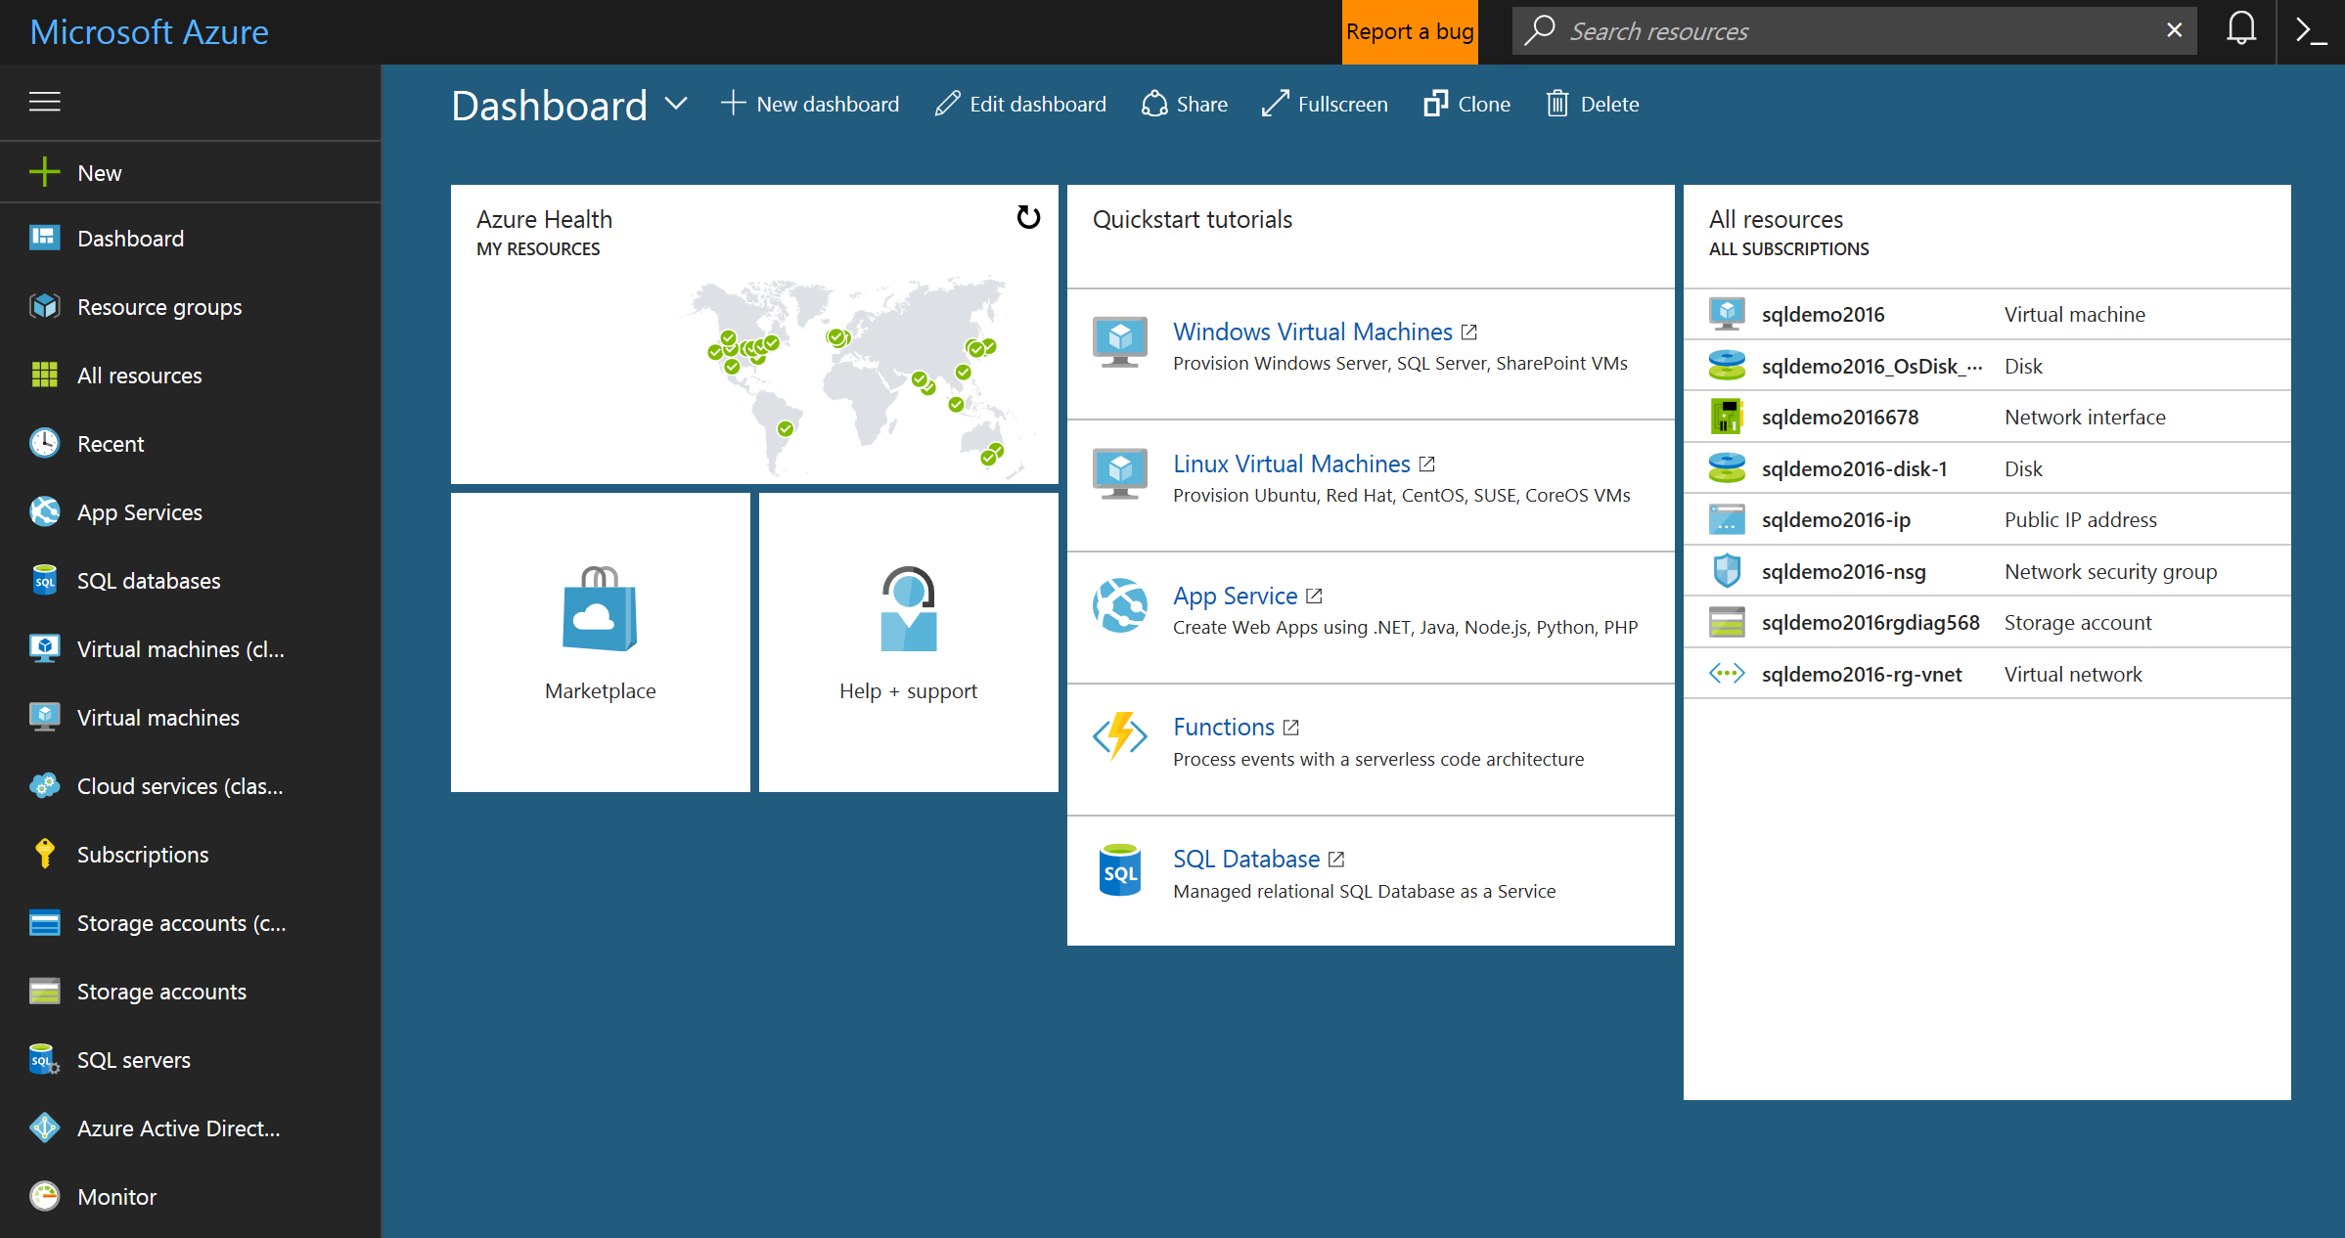
Overview of Azure Management Portal
Web interface to administer most resources (but not all)
Access, deploy, configure, monitor
https://portal.azure.com
Notes:
Azure Management Portal
Azure has a web interface called the Management Portal that allows administrators to access and administer most, but not all Azure features. Microsoft typically releases the newer UI portal in beta before retiring an older one. The newer one is called the "Azure Preview Portal".
There is typically a long overlap when both portals are active. While core services will appear in both portals, not all functionality may be available in both. Newer services may show up in the newer portal first and older services and functionality may only exist in the older one. The message here is that if you don't find something in the older portal, check the newer one and vice-versa.

Slide 25
Resource Groups
A unit of management
Application Lifecycle Containment – Deployment, update, delete and status
Declarative solution for Deployment – “Config as Code”
Consistent Management Layer
Access Control – Scope for RBAC permissions
Notes:
Slide Objectives
To discuss the concept of a resource group
Notes
Application Lifecycle Containment – You can deploy everything included in a resource group together, thereby maintaining versions of an application along with it’s resources.
Declarative Solution – RG’s are .json, declarative/configuration code
Grouping – Resource groups provide a logical grouping of resources
Consistent Management Layer – In the V2 portal, everything is controlled in a RG. RGs can be accessed via REST APIs and resource providers
Access Control – You can only use RBAC in the new portal and the highest level generally used for RBAC is the resource group level. There is a Subscription Admin role, but that is typically not the type of things customers are interested in assigning to IT Pros or Developers

Slide 26
Azure Resource Groups
Tightly coupled containers of multiple resources of similar or different types
Resource groups can span regions
Every resource *must* exist in one and only one resource group
RESOU
R
CE G
R
OUP
Notes:
Resource Groups
When resources are in the container, they have a common lifecyle. You can deploy these things together, put RBAC on them together with one request and they can know about each other
Every resource must be in ONE resource group, important for RBAC
Don’t have to live in same location, can deploy to multiple regions
Resources can be heterogenous or homogenous

Slide 27
Resource Group Lifecycle
Question:
Should these resources be in the same group or a different one?
Hint:
Do they have common lifecycle and management?
Answer:
It’s up to you.
Notes:
Most significant question is of lifecycle and what to place in a resource group
Can apply RBAC, but is this right for a particular resource group?
Sometimes resources are shared across multiple applications, in other words a VM could be stored in a storage account in a different resource group
Lifecycle is distinct and managed by different people
No hard and fast rule

Slide 28
Microsoft Azure Virtual Network
Your virtual branch office/data center in the cloud
Allows customers to extend their Enterprise Networks into Microsoft Azure
Networking on-ramp for migrating existing apps and services to Microsoft Azure
Allows customers to run hybrid apps that span the cloud and their on-premises setup
A protected private virtual network in the cloud
Allows customers to set up secure private IPv4 or IPv6 networks fully contained within Microsoft Azure
IP address persistence capability
Notes:
An Azure virtual network (VNet) is a representation of your own network in the cloud. It is a logical isolation of the Azure cloud dedicated to your subscription. You can fully control the IP address blocks, DNS settings, security policies, and route tables within this network. You can also further segment your VNet into subnets and launch Azure IaaS virtual machines (VMs) and/or Cloud Services (PaaS role instances). Additionally, you can connect the virtual network to your on-premises network using one of the connectivity options available in Azure. In essence, you can expand your network to Azure, with complete control on IP address blocks with the benefit of enterprise scale Azure provides.
Microsoft Azure Virtual Network is our solution to providing:
Hybrid solutions
Solutions that require advanced connectivity in the cloud
Hybrid (on-premises to cloud) connectivity is enabled by using the Virtual Private Network (VPN) solution that allows site-to-site connectivity allowing machines on-premises and machines in the cloud to appear on the same network
Advanced connectivity solutions are enabled because Microsoft Azure applications that are deployed to a virtual network will have persistent IP addresses. This is a requirement for solutions like Active Directory
Other solutions enabled by virtual networks in the cloud are mixing VMs and web/worker role solutions in the same Microsoft Azure network. This allows for scenarios such as web/worker roles communicating back to VMs running applications such as SQL server.
For more information, refer to
“Virtual Network Overview” (https://azure.microsoft.com/en-us/documentation/articles/virtual-networks-overview/) and
“IPv6 for Azure VMs available in most regions” (https://azure.microsoft.com/en-us/updates/ipv6-for-azure-vms/).

Slide 29
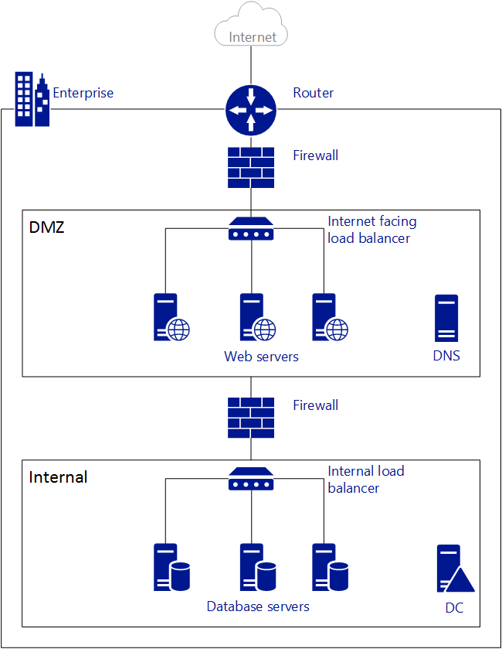
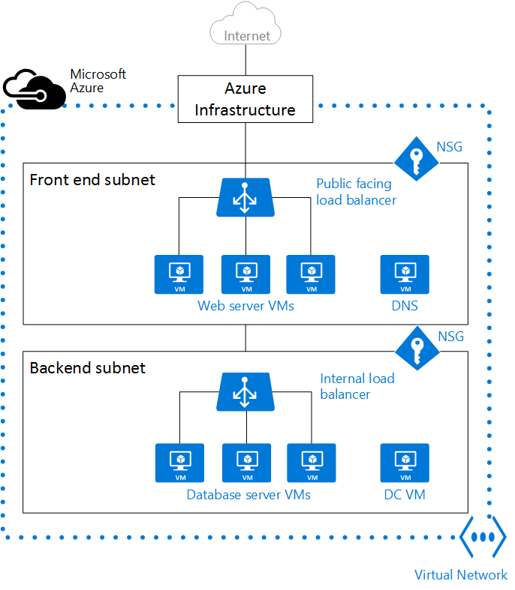
Microsoft Azure Virtual Network
On-premises Network to
Azure Virtual Network
Notes:
The figure on the left shows an on-premises network connected to the public Internet through a router. You can also see a firewall between the router and a DMZ hosting a DNS server and a web server farm. The web server farm is load balanced using a hardware load balancer that is exposed to the Internet, and consumes resources from the internal subnet. The internal subnet is separated from the DMZ by another firewall, and hosts Active Directory Domain Controller servers, database servers, and application servers.
The same network can be hosted in Azure as shown in the figure on the right. Notice how the Azure infrastructure takes on the role of the router, allowing access from your VNet to the public Internet without the need of any configuration. Firewalls can be substituted by Network Security Groups (NSGs) applied to each individual subnet. And physical load balancers are substituted by internet facing and internal load balancers in Azure.
For more information, refer to “Virtual Network Overview” (https://azure.microsoft.com/en-us/documentation/articles/virtual-networks-overview/).

Slide 30
Virtual Machine Access
VMs can automatically communicate with other VMs in the same virtual network
Computers on the Internet or other virtual networks require endpoints to direct the inbound network traffic to a virtual machine
Network Security Groups are recommended for configuring endpoint security rules
Notes:
All virtual machines that you create in Azure can automatically communicate using a private network channel with other virtual machines in the same virtual network in a resource group. However, other resources on the Internet or other virtual networks require endpoints to handle the inbound network traffic to the virtual machine.
When you create a virtual machine in the Management Portal, you can create these inbound security rules, such as for Remote Desktop, Windows PowerShell Remoting, or Secure Shell (SSH). After you create the virtual machine, if you have a network security group, you can create additional inbound security rules as needed. You also can manage incoming traffic to the inbound security rule.

Slide 31
Network Security Groups
Contains a list of Access Control List (ACL) rules that restrict traffic to and from VMs based on IP address and port range
Inbound Security Rules – Source IP address and port range
Outbound Security Rules – Destination IP address and port range
NSGs can be associated with VMs, NICs or subnets
Notes:
You can use an NSG to control traffic to one or more virtual machines (VMs), role instances, network adapters (NICs), or subnets in your virtual network. An NSG contains access control rules that allow or deny traffic based on traffic direction, protocol, source address and port, and destination address and port. The rules of an NSG can be changed at any time, and changes are applied to all associated instances.
For more information on how to create and manage NSGs using the Azure portal, refer to “How to manage NSGs using the Azure portal “ (https://azure.microsoft.com/en-us/documentation/articles/virtual-networks-create-nsg-arm-pportal/).

Slide 32
Virtual Network Connectivity Options
Point-to-Site
Site-to-Site
ExpressRoute
Notes:
Since a majority of the enterprise customers may take years to migrate their existing IT infrastructure to Azure, Microsoft has provided options for connecting customers’ on-premises environment to a Microsoft Azure Virtual Network. They are as follows.
Point-to-site VPN
Site-to-site VPN
ExpressRoute
We will discuss these in detail on the next slides.

Slide 33


Point-to-Site (P2S)
The Corp. HQ
Virtual Network
SQL Server
WA Web Role
VPN Tunnel
Client 1
Notes:
This is the simplest way to securely connect a local computer to an Azure Virtual Network. For Point-to-Site (P2S) VPN connectivity, you don’t need a VPN device. Instead, you install a Windows VPN client and use it to connect to VMs and other cloud services in the Virtual Network.
A P2S connection is useful when you want to connect to your VNet from a remote location, such as from home or a conference, or when you only have a few clients that need to connect to a virtual network.
For more information on how to configure a P2S VPN, refer to “Configure a Point-to-Site connection to a VNet using PowerShell” (https://azure.microsoft.com/en-us/documentation/articles/vpn-gateway-howto-point-to-site-rm-ps/ ).

Slide 34


Site-to-Site (S2S)
Microsoft Azure
<subnet 1>
<subnet 2>
<subnet 3>
Virtual Network
DNS Server
Site-to-Site VPN
On-premises Datacenter
VPN Gateway
VPN Gateway
Hardware VPN or Windows RRAS
Notes:
Site-to-Site (S2S) VPN can be used to create a hybrid solution, or whenever you want a secure connection between your on-premises network and your virtual network. It is designed for establishing secured connections between site offices and the cloud, or bridging on-premises networks with virtual networks in Azure.
S2S can also be used to bring the VMs in the cloud into the local domain and have security policies applied to it. This can be useful when you want to move your domain-joined servers to the cloud but keep them on the local Active Directory or you have migrated the application servers to Azure but want to keep the data on-premises.
A VPN device is required to configure a S2S VPN connection. A public-facing IPv4 IP address is also required for the VPN device.
For more information on how to configure S2S VPN, refer to “Create a VNet with a Site-to-Site connection using the Azure portal” (https://azure.microsoft.com/en-us/documentation/articles/vpn-gateway-howto-site-to-site-resource-manager-portal/).

Slide 35
ExpressRoute
Provides organizations a private, dedicated, high-throughput network connection between Azure datacenters and their on-premises IT environment.
Predictable performance
Security
High throughput
Lower cost
Notes:
Microsoft Azure ExpressRoute lets you extend your on-premises networks into the Microsoft cloud over a dedicated private connection facilitated by a connectivity provider. With ExpressRoute, you can establish connections to Microsoft cloud services, such as Microsoft Azure, Office 365, and CRM Online. Connectivity can be from an any-to-any (IP VPN) network, a point-to-point Ethernet network, or a virtual cross-connection through a connectivity provider at a co-location facility. ExpressRoute connections do not go over the public Internet. This allows ExpressRoute connections to offer more reliability, faster speeds, lower latencies, and higher security than typical connections over the Internet.
With ExpressRoute, you can choose the network performance you desire. Your can design apps to meet QoS and SLA requirements.
ExpressRoute provides a private dedicated connection between Azure and your datacenter, so you don’t have to rely on the shared network infrastructure of the Internet.
With up to 10Gps dedicated connection, you have a extremely high bandwidth connection between Azure datacenters and your IT environment.
For transferring large datasets in and out of Azure datacenters, ExpressRoute provides an economically cheaper alternative.
For more information on ExpressRoute, refer to “ExpressRoute technical overview” (https://azure.microsoft.com/en-us/documentation/articles/expressroute-introduction/).

Slide 36
Azure Storage
Pay for what you use
Exposed via easy and open REST APIs, Client Libraries and Tools
Durable, Highly Available and Massively Scalable
High-performance, low-latency disk support for I/O intensive workloads running on Azure Virtual Machines
Notes:
Cloud Storage - Anywhere and anytime access
Easily build “internet scale” applications
More than 20 trillion stored objects
2+ million requests/sec on average

Slide 37
Azure Storage Options
Disk storage
Premium storage for I/O-intensive applications
Blob storage
Blob can be any type of text or binary data, such as a document, media file, or application installer
Table storage
Table storage is a NoSQL key-attribute data
Queue storage
Durable messaging for workflow processing and for communication between components of cloud services.
File storage
Shared storage for legacy applications using the standard SMB 2.1 protocol
Notes:
Blob storage stores file data. A blob can be any type of text or binary data, such as a document, media file, or application installer.
Blobs – Massively scalable object store in the cloud
Simple REST interface (Put, Get, Delete)
Data sharing – share documents, pictures, video, music, etc.
Big Data – store raw data/logs and compute/map reduce over data
Backups – data and device backups
Table storage stores structured datasets. Table storage is a NoSQL key-attribute data store, which allows for rapid development and fast access to large quantities of data.
Tables – Massively scalable NoSQL cloud store
Key/Attribute(s) store at scale
Auto load balance partitions to meet traffic needs
Store user, device or any type of metadata for your service
OData protocol (AtomPub or JSON - recomended)
Queue storage provides reliable messaging for workflow processing and for communication between components of cloud services.
Queues – Reliable messaging system
Reliable, low latency, high throughput messaging system
Decouple components/roles
Web role to worker role communication
Allows roles to scale independently
Implement scheduling of asynchronous tasks
Building process/work flows
File storage (Preview) offers shared storage for legacy applications using the standard SMB 2.1 protocol. Azure virtual machines and cloud services can share file data across application components via mounted shares, and on-premise applications can access file data in a share via the File service REST API. File storage is available by request via the Azure Preview page.

Slide 38
Azure Storage Options
Description | Blob | File
Durability Options | LRS, ZRS, GRS (and RA-GRS for higher availability) | LRS, GRS
Accessibility | REST APIs | SMB 2.1 (standard file system APIs) REST APIs
Connectivity | REST – Worldwide | SMB 2.1 - Within region REST – Worldwide
Endpoints | http://myaccount.blob.core.windows.net/mycontainer/myblob | \\myaccount.file.core.windows.net\myshare\myfile.txt http://myaccount.file.core.windows.net/myshare/myfile.txt
Directories | Flat namespace however prefix listing can simulate virtual directories | True directory objects
Case Sensitivity of Names | Case sensitive | Case insensitive, but case preserving
Capacity | Up to 500TB containers | 5TB file shares
Throughput | Up to 60 MB/s per blob | Up to 60 MB/s per share
Object size | Up to 1 TB/blob | Up to 1 TB/file
Billed capacity | Based on bytes written | Based on file size

Slide 39
Azure Storage Options
Description | Disk | File
Relationship with Azure VMs | Required for booting (OS Disk)
Scope | Exclusive/Isolated to a single VM | Shared access across multiple VMs
Snapshots and Copy | Yes | No
Configuration | Configured via portal/Management APIs and available at boot time | Connect after boot (via net use on windows)
Built-in authentication | Built-in authentication | Set up authentication on net use
Cleanup | Resources can be cleaned up with VM if needed | Manually via standard file APIs or REST APIs
Access via REST | Can only access as fixed formatted VHD (single blob) via REST. Files stored in VHD cannot be accessed via REST. | Individual files stored in share are accessible via REST
Max Size | 1TB Disk | 5TB File Share 1TB file within share
Max 8KB IOps | 500 IOps | 1000 IOps
Throughput | Up to 60 MB/s per Disk | Up to 60 MB/s per File Share

Slide 40
Azure Storage Replication Options
Locally redundant storage (LRS)
Zone-redundant storage (ZRS)
Geo-redundant storage (GRS)
Read access geo-redundant storage (RA-GRS)
Replication strategy | LRS | ZRS | GRS | RA-GRS
Data is replicated across multiple facilities. | No | Yes | Yes | Yes
Data can be read from both primary and secondary location. | No | No | No | Yes
Number of copies of data maintained on separate nodes. | 3 | 3 | 6 | 6
Notes:
Locally redundant storage (LRS). Locally redundant storage maintains three copies of your data. LRS is replicated three times within a single facility in a single region. LRS protects your data from normal hardware failures, but not from the failure of a single facility. LRS is offered at a discount. For maximum durability, we recommend that you use geo-redundant storage, described below.
Zone-redundant storage (ZRS). Zone-redundant storage maintains three copies of your data. ZRS is replicated three times across two to three facilities, either within a single region or across two regions, providing higher durability than LRS. ZRS ensures that your data is durable within a single region. ZRS provides a higher level of durability than LRS; however, for maximum durability, we recommend that you use geo-redundant storage, described below.
Geo-redundant storage (GRS). GRS maintains six copies of your data. With GRS, your data is replicated three times within the primary region, and is also replicated three times in a secondary region hundreds of miles away from the primary region, providing the highest level of durability. In the event of a failure at the primary region, Azure Storage will failover to the secondary region. GRS ensures that your data is durable in two separate regions.
Read access geo-redundant storage (RA-GRS). Read access geo-redundant storage replicates your data to a secondary geographic location, and also provides read access to your data in the secondary location. Read-access geo-redundant storage allows you to access your data from either the primary or the secondary location, in the event that one location becomes unavailable.
For additional information, refer to “Azure Storage replication” (https://azure.microsoft.com/en-us/documentation/articles/storage-redundancy/).

Slide 41
Developing Against Azure Storage
Azure Storage exposes storage resources via a REST API
Can be called by any language that can make HTTP / HTTPS requests
Azure Storage offers programming libraries for several popular languages
Tools and Libraries
Client libraries
PowerShell commands
Notes:
Developing Against Storage
Azure Storage exposes storage resources via a REST API that can be called by any language that can make HTTP/HTTPS requests. Additionally, Azure Storage offers programming libraries for several popular languages. These libraries simplify many aspects of working with Azure Storage by handling details such as synchronous and asynchronous invocation, batching of operations, exception management, automatic retries, operational behavior and so forth. Libraries are currently available for the following languages and platforms, with others in the pipeline:
.NET
Native code
Java/Android
Node.js
PHP
Ruby
Python
PowerShell
Downloads
Azure Storage NuGet Package - Client Libraries for .NET, Windows Phone, and Windows Runtime
Azure SDKs and Tools
Azure Storage Emulator
Source Code
Microsoft Azure Storage Libraries for .NET
Documentation
Azure Storage Documentation
Azure Storage Services REST API Reference
AzCopy Command-Line Tool Reference
For PowerShell Users
Azure Storage Cmdlets
For .NET Developers
.NET Client Library Reference
How to use Blob Storage from .NET
How to use Table Storage from .NET
How to use Queue Storage from .NET
For Java/Android Developers
Java Client Library Reference
How to use Blob Storage from Java/Android
How to use Table Storage from Java/Android
How to use Queue Storage from Java/Android
For Node.js Developers
How to use Blob Storage from Node.js
How to use Table Storage from Node.js
How to use Queue Storage from Node.js
For PHP Developers
How to use Blob Storage from PHP
How to use Table Storage from PHP
How to use Queue Storage from PHP
For Ruby Developers
How to use Blob Storage from Ruby
How to use Table Storage from Ruby
How to use Queue Storage from Ruby
For Python Developers
How to use Blob Storage from Python
How to use Table Storage from Python
How to use Queue Storage from Python

Slide 42
Azure Storage Architecture
REST
REST
REST
REST
SMB
Blob/Disk
Head
Table
Head
Queue
Head
File Share
Head
Massive Scale Out & Auto Load Balancing Index Layer
Distributed Replication Layer

Slide 43
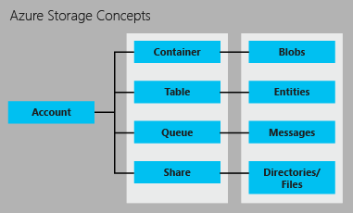
Overview of Storage Account
Notes:
Each standard storage account can contain up to 500 TB of combined blob, queue, table, and file data. See the Azure Storage Scalability and Performance Targets for details about standard storage account capacity.
The image below shows the relationships between the Azure storage resources in a standard storage account:
Blob Storage
Every blob is organized into a container. Containers also provide a useful way to assign security policies to groups of objects. A storage account can contain any number of containers, and a container can contain any number of blobs, up to the 500 TB capacity limit of the storage account.
Blob storage offers two types of blobs, block blobs and page blobs (disks). Block blobs are optimized for streaming and storing cloud objects, and are a good choice for storing documents, media files, backups etc. A block blob can be up to 200 GB in size. Page blobs are optimized for representing IaaS disks and supporting random writes, and may be up to 1 TB in size. An Azure virtual machine network attached IaaS disk is a VHD stored as a page blob.
For very large datasets where network constraints make uploading or downloading data to Blob storage over the wire unrealistic, you can ship a hard drive to Microsoft to import or export data directly from the data center using the Azure Import/Export Service. You can also copy blob data within your storage account or across storage accounts.
Table Storage
Modern applications often demand data stores with greater scalability and flexibility than previous generations of software required. Table storage offers highly available, massively scalable storage, so that your application can automatically scale to meet user demand. Table storage is Microsoft’s NoSQL key/attribute store – it has a schemaless design, making it different from traditional relational databases. With a schemaless data store, it's easy to adapt your data as the needs of your application evolve. Table storage is easy to use, so developers can create applications quickly. Access to data is fast and cost-effective for all kinds of applications. Table storage is typically significantly lower in cost than traditional SQL for similar volumes of data.
Table storage is a key-attribute store, meaning that every value in a table is stored with a typed property name. The property name can be used for filtering and specifying selection criteria. A collection of properties and their values comprise an entity. Since Table storage is schemaless, two entities in the same table can contain different collections of properties, and those properties can be of different types.
You can use Table storage to store flexible datasets, such as user data for web applications, address books, device information, and any other type of metadata that your service requires. You can store any number of entities in a table, and a storage account may contain any number of tables, up to the capacity limit of the storage account.
Like Blobs and Queues, developers can manage and access Table Storage using standard REST protocols, however Table Storage also supports a subset of the OData protocol, simplifying advanced querying capabilities and enabling both JSON and AtomPub (XML based) formats.
Queue Storage
In designing applications for scale, application components are often decoupled, so that they can scale independently. Queue storage provides a reliable messaging solution for asynchronous communication between application components, whether they are running in the cloud, on the desktop, on an on-premises server, or on a mobile device. Queue storage also supports managing asynchronous tasks and building process workflows.
A storage account can contain any number of queues. A queue can contain any number of messages, up to the capacity limit of the storage account. Individual messages may be up to 64 KB in size.
File Storage (Preview)
Many legacy applications rely on file shares, a dependency that has complicated moving these applications to the cloud. File storage offers cloud-based file shares, so that you can migrate legacy applications to Azure quickly and without costly rewrites.
Applications running in Azure virtual machines or cloud services can mount a File storage share to access file data, just as a desktop application would mount a typical SMB share. Any number of application components can mount and access the File storage share simultaneously.
Since a File storage share is a standard SMB 2.1 file share, applications running in Azure can access data in the share via file sytem I/O APIs. Developers can therefore leverage their existing code and skills to migrate existing applications. IT Pros can use PowerShell cmdlets to create, mount, and manage File storage shares as part of the administration of Azure applications.
Like the other Azure storage services, File storage exposes a REST API for accessing data in a share. On-premise applications can call the File storage REST API to access data in a file share. This way, an enterprise can choose to migrate some legacy applications to Azure and continue running others from within their own organization. Note that mounting a file share is only possible for applications running in Azure; an on-premise application may only access the file share via the REST API.
Distributed applications can also use File storage to store and share useful application data and development and testing tools. For example, an application may store configuration files and diagnostic data such as logs, metrics, and crash dumps in a File storage share so that they are available to multiple virtual machines or roles. Developers and administrators can store utilities that they need to build or manage an application in a File storage share that is available to all components, rather than installing them on every virtual machine or role instance.

Slide 44
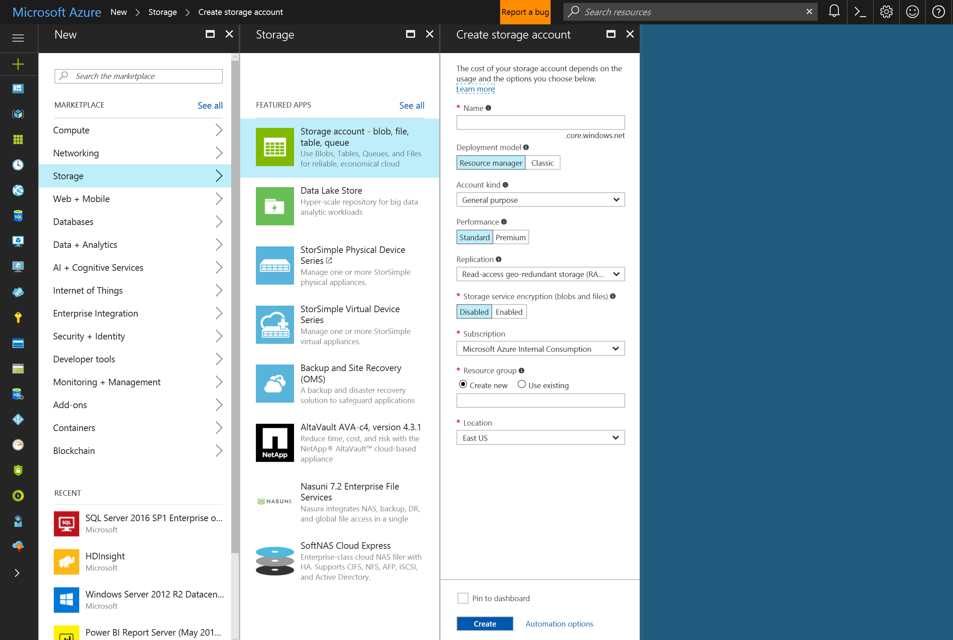
Overview of Storage Account
Notes:
Each standard storage account can contain up to 500 TB of combined blob, queue, table, and file data. See the Azure Storage Scalability and Performance Targets for details about standard storage account capacity.
Blob Storage
Every blob is organized into a container. Containers also provide a useful way to assign security policies to groups of objects. A storage account can contain any number of containers, and a container can contain any number of blobs, up to the 500 TB capacity limit of the storage account.
Blob storage offers two types of blobs, block blobs and page blobs (disks). Block blobs are optimized for streaming and storing cloud objects, and are a good choice for storing documents, media files, backups etc. A block blob can be up to 200 GB in size. Page blobs are optimized for representing IaaS disks and supporting random writes, and may be up to 1 TB in size. An Azure virtual machine network attached IaaS disk is a VHD stored as a page blob.
For very large datasets where network constraints make uploading or downloading data to Blob storage over the wire unrealistic, you can ship a hard drive to Microsoft to import or export data directly from the data center using the Azure Import/Export Service. You can also copy blob data within your storage account or across storage accounts.
Table Storage
Modern applications often demand data stores with greater scalability and flexibility than previous generations of software required. Table storage offers highly available, massively scalable storage, so that your application can automatically scale to meet user demand. Table storage is Microsoft’s NoSQL key/attribute store – it has a schemaless design, making it different from traditional relational databases. With a schemaless data store, it's easy to adapt your data as the needs of your application evolve. Table storage is easy to use, so developers can create applications quickly. Access to data is fast and cost-effective for all kinds of applications. Table storage is typically significantly lower in cost than traditional SQL for similar volumes of data.
Table storage is a key-attribute store, meaning that every value in a table is stored with a typed property name. The property name can be used for filtering and specifying selection criteria. A collection of properties and their values comprise an entity. Since Table storage is schemaless, two entities in the same table can contain different collections of properties, and those properties can be of different types.
You can use Table storage to store flexible datasets, such as user data for web applications, address books, device information, and any other type of metadata that your service requires. You can store any number of entities in a table, and a storage account may contain any number of tables, up to the capacity limit of the storage account.
Like Blobs and Queues, developers can manage and access Table Storage using standard REST protocols, however Table Storage also supports a subset of the OData protocol, simplifying advanced querying capabilities and enabling both JSON and AtomPub (XML based) formats.
Queue Storage
In designing applications for scale, application components are often decoupled, so that they can scale independently. Queue storage provides a reliable messaging solution for asynchronous communication between application components, whether they are running in the cloud, on the desktop, on an on-premises server, or on a mobile device. Queue storage also supports managing asynchronous tasks and building process workflows.
A storage account can contain any number of queues. A queue can contain any number of messages, up to the capacity limit of the storage account. Individual messages may be up to 64 KB in size.
File Storage (Preview)
Many legacy applications rely on file shares, a dependency that has complicated moving these applications to the cloud. File storage offers cloud-based file shares, so that you can migrate legacy applications to Azure quickly and without costly rewrites.
Applications running in Azure virtual machines or cloud services can mount a File storage share to access file data, just as a desktop application would mount a typical SMB share. Any number of application components can mount and access the File storage share simultaneously.
Since a File storage share is a standard SMB 2.1 file share, applications running in Azure can access data in the share via file sytem I/O APIs. Developers can therefore leverage their existing code and skills to migrate existing applications. IT Pros can use PowerShell cmdlets to create, mount, and manage File storage shares as part of the administration of Azure applications.
Like the other Azure storage services, File storage exposes a REST API for accessing data in a share. On-premise applications can call the File storage REST API to access data in a file share. This way, an enterprise can choose to migrate some legacy applications to Azure and continue running others from within their own organization. Note that mounting a file share is only possible for applications running in Azure; an on-premise application may only access the file share via the REST API.
Distributed applications can also use File storage to store and share useful application data and development and testing tools. For example, an application may store configuration files and diagnostic data such as logs, metrics, and crash dumps in a File storage share so that they are available to multiple virtual machines or roles. Developers and administrators can store utilities that they need to build or manage an application in a File storage share that is available to all components, rather than installing them on every virtual machine or role instance.

Slide 45
How To Load Data To Azure Storage
Storage Explorer
AZCopy – Now on Linux!
Azure Data Factory
Data Management Gateway (coming up in ADF Module).
Python
blob_service.put_block_blob_from_path("<your_container_name>", "<your_blob_name>", "<your_local_file_name>")
SSIS
SSIS Feature Pack for Azure
Azure Blob Upload Task

Slide 46
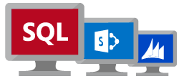
Azure Virtual Machine
An Azure Virtual Machine gives you the flexibility of virtualization without having to buy and maintain the physical hardware that runs the virtual machine.
You still need to maintain the virtual machine: configuring, patching, and maintaining the software that runs on the virtual machine.
Microsoft Confidential
Notes:
Azure Virtual Machines is one of several types of on-demand, scalable computing resources that Azure offers.
An Azure virtual machine gives you the flexibility of virtualization without having to buy and maintain the physical hardware that runs the virtual machine. However, you still need to maintain the virtual machine -- configuring, patching, and maintaining the software that runs on the virtual machine
Azure charges an hourly price based on the VM’s size and operating system. For partial hours, Azure charges only for the minutes of use. Storage is priced and charged separately.
Azure monitors the physical hardware that hosts each running VM. If a physical server running a VM fails, Azure notices this, moves the VM to new hardware and restarts the VM. This process is sometimes called service healing. Azure also helps protect a virtual machine's data, by keeping redundant copies of the VHDs in blob storage.
About Windows virtual machines in Azure https://azure.microsoft.com/en-us/documentation/articles/virtual-machines-windows-about/

Slide 47
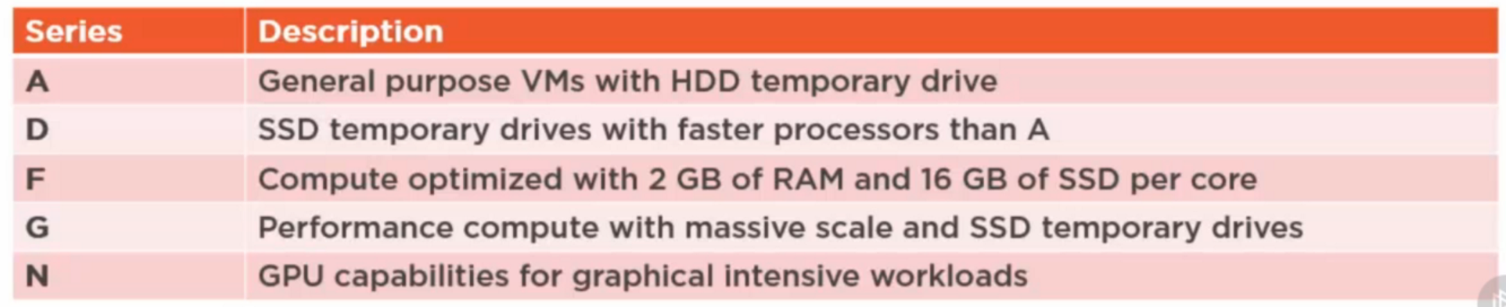

Azure Virtual Machine Sizes
Each series have different capabilities such as SSD local drives or support for Premium Storage.
The size affects the processing, memory, and storage capacity and pricing of the virtual machine.
https://azure.microsoft.com/en-us/documentation/articles/virtual-machines-windows-sizes/
Microsoft Confidential
Notes:
For further information refer to the link below:
Sizes for virtual machines in Azure https://azure.microsoft.com/en-us/documentation/articles/virtual-machines-windows-sizes/

Slide 48
Availability Sets
Provides 99.95% SLA
Allows to spread VMs across fault domains and update domains
Fault Domains
Avoids unavailability of VMs due to single point of failure such as Power unit etc.
Update Domains
Each update domain in the environment is upgraded distinctly so that all the VMs are not updated or not unavailable at the same time
Microsoft Confidential

Slide 49
Overview of Azure Tools
Microsoft Azure Storage Explorer
Standalone app from Microsoft that allows you to easily work with Azure Storage data (Blob, Table, Queue, and File) on Windows, macOS and Linux.
Download: http://storageexplorer.com/
Azure Powershell
Azure PowerShell is a set of modules that provide cmdlets to manage Azure with Windows PowerShell
https://docs.microsoft.com/en-us/powershell/azure/overview

Slide 50
Overview of Azure Tools
Azure Command-Line Interface (Azure CLI)
Command line experience for managing Azure resources
Manage and administer Azure resources from the command line
Build automation scripts that work against the Azure Resource Manager
Several options to install Azure CLI on your computer
macOS – Install with one curl command
Windows – Download and run the CLI msi
Bash on Ubuntu on Windows – Install with apt-get
Linux – Install with one curl command or use apt-get. There are some prerequisites, depending on which Linux distribution is used.
Docker – Use a ready Docker image preconfigured with the Azure CLI
Details: https://docs.microsoft.com/en-us/cli/azure/install-azure-cli

Slide 51
Overview of Azure Tools
Azure Command-Line Interface (Azure CLI)
Command line experience for managing Azure resources
Manage and administer Azure resources from the command line
Build automation scripts that work against the Azure Resource Manager
Several options to install Azure CLI on your computer
macOS – Install with one curl command
Windows – Download and run the CLI msi
Bash on Ubuntu on Windows – Install with apt-get
Linux – Install with one curl command or use apt-get. There are some prerequisites, depending on which Linux distribution is used.
Docker – Use a ready Docker image preconfigured with the Azure CLI
Details: https://docs.microsoft.com/en-us/cli/azure/install-azure-cli
Notes:
Details: https://docs.microsoft.com/en-us/cli/azure/overview

Slide 52
Overview of Azure Tools
Azure Cloud Shell
Interactive, browser-accessible shell for managing Azure resources
Comes pre-installed with popular command-line tools and language support
Securely authenticates automatically on each session for instant access to your resources through the Azure CLI
Cloud Shell runs on a temporary machine provided on a per-session, per-user basis
Cloud Shell times out after 10 minutes without interactive activity
Cloud Shell can only be accessed with a file share attached
Cloud Shell is assigned one machine per user account
Permissions are set as a regular Linux user
Supported browsers: Edge, IE, Chrome, Safari, and Firefox
Notes:
https://docs.microsoft.com/en-us/azure/cloud-shell/overview

Slide 53
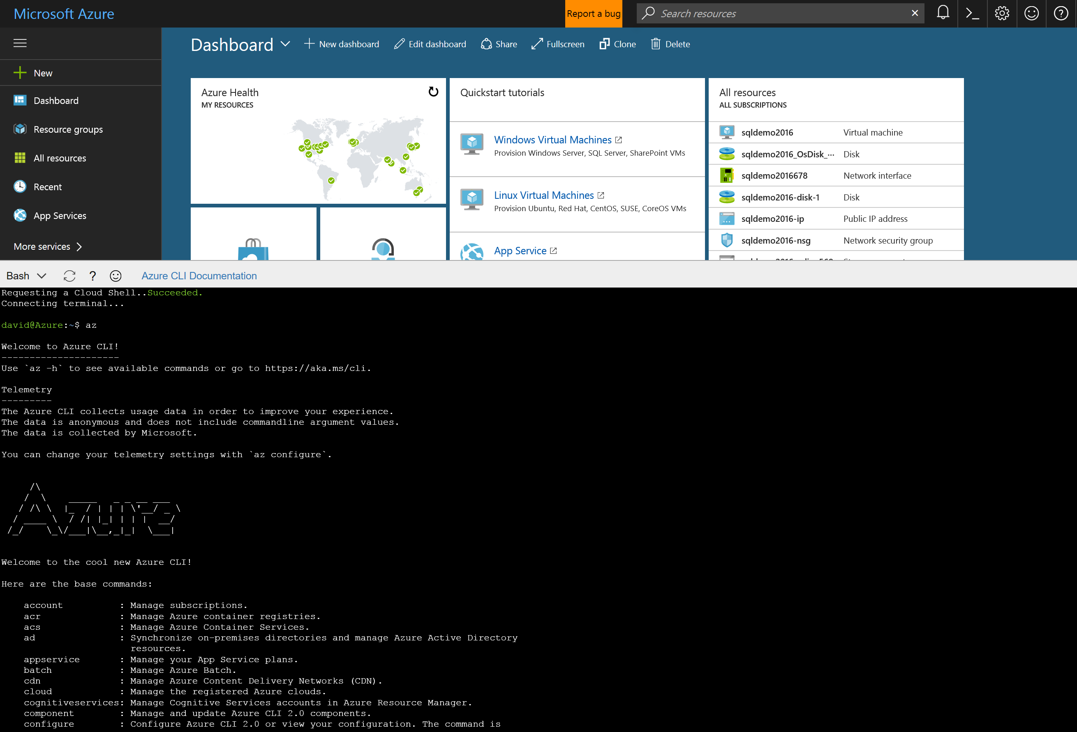
Notes:
https://docs.microsoft.com/en-us/azure/cloud-shell/overview

Slide 54
ARM Templates
SQL-A
Instantiation of repeatable config.
Configuration → Resource Group
What?
Source file, can be checked-in
Specifies resources, dependencies and connections
Parameterized input/output
Why?
Ensure Idempotency
Simplify orchestration
Provide cross-resource configuration and update support
Website
[SQL CONFIG] VM (2x)
DEPENDS ON SQL
DEPENDS ON SQL
SQL - A
Website
Virtual
Machines
SQL
C
ONFIG
Notes:
Written in JSON, describes entities
Template execution engine can interpret dependencies and relationships and orchestrate the deployment of the resources for you
Resources at the bottom of the stack are deployed first
Idempotent, can redeploy and get the same goal state
Parameterized input and output – reuse template in different environments
Templates are represented in the gallery

Slide 55
ARM Template Syntax
JavaScript Object Notation (JSON) syntax
Objects are unordered sets of name and value pairs
An object begins with left curly brace { and ends with right curly brace }
Each name and value is enclosed by double quotes “”
Names and values are delimited by a colon :
Name and value pairs are delimited by a comma ,
Notes:
Written in JSON, describes entities
Template execution engine can interpret dependencies and relationships and orchestrate the deployment of the resources for you
Resources at the bottom of the stack are deployed first
Idempotent, can redeploy and get the same goal state
Parameterized input and output – reuse template in different environments
Templates are represented in the gallery

Slide 56
JSON Syntax Example
{
"name": "myVm001",
"type": "Microsoft.Compute/virtualMachines",
"location": "australiaeast",
"apiVersion": "2015-05-01-preview",
"dependsOn": [
"'Microsoft.Storage/storageAccounts/myStor001'",
"'Microsoft.Network/networkInterfaces/myNic001'"
],
"tags": {
"displayName": "Web VM"
}
}
Notes:
Sample bit of code that, over the next few slides, walks through the JSON Syntax usage

Slide 57
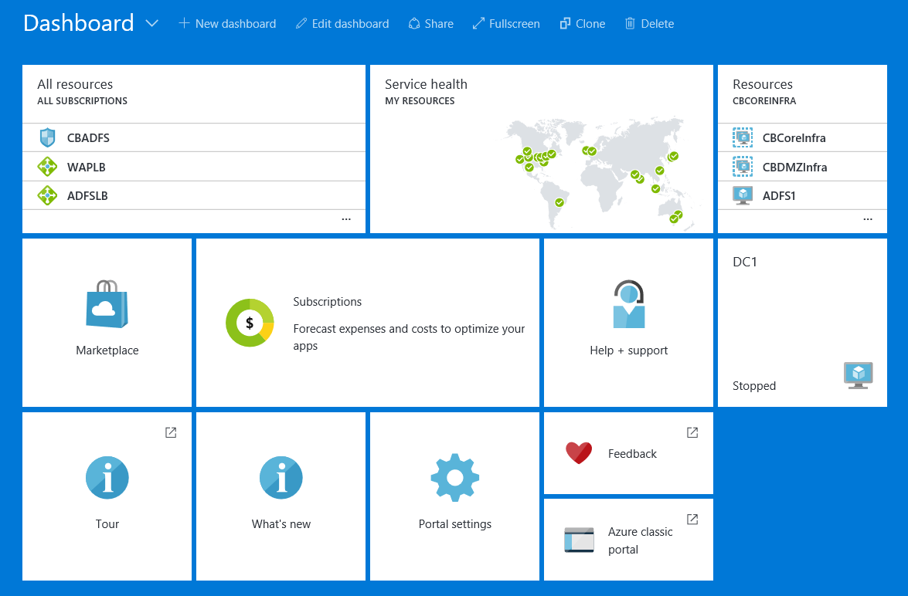
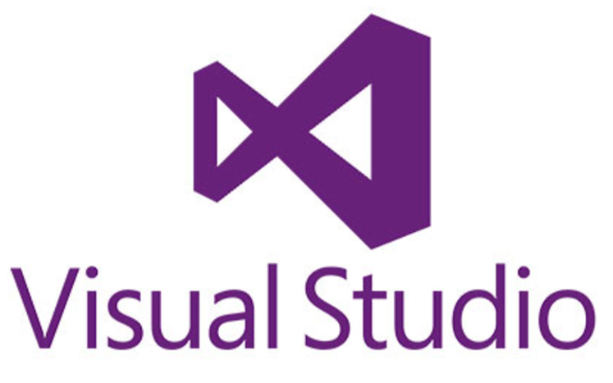

Authoring ARM Templates
ARM templates can be authored using different tools, some of the most common tools in use today are:
Visual Studio with Azure SDK
New Azure Portal
GitHub
Template files must be <1MB in size
Parameter files must be <64 KB in size
Notes:
These tools help simplify viewing the template and also include syntax error checking.
As a best practice, ARM template files must be less than 1 MB in size and parameter files must be less than 64 KB in size.
This prevents ARM templates from being used maliciously and also helps to create a simpler deployment model.

Slide 58
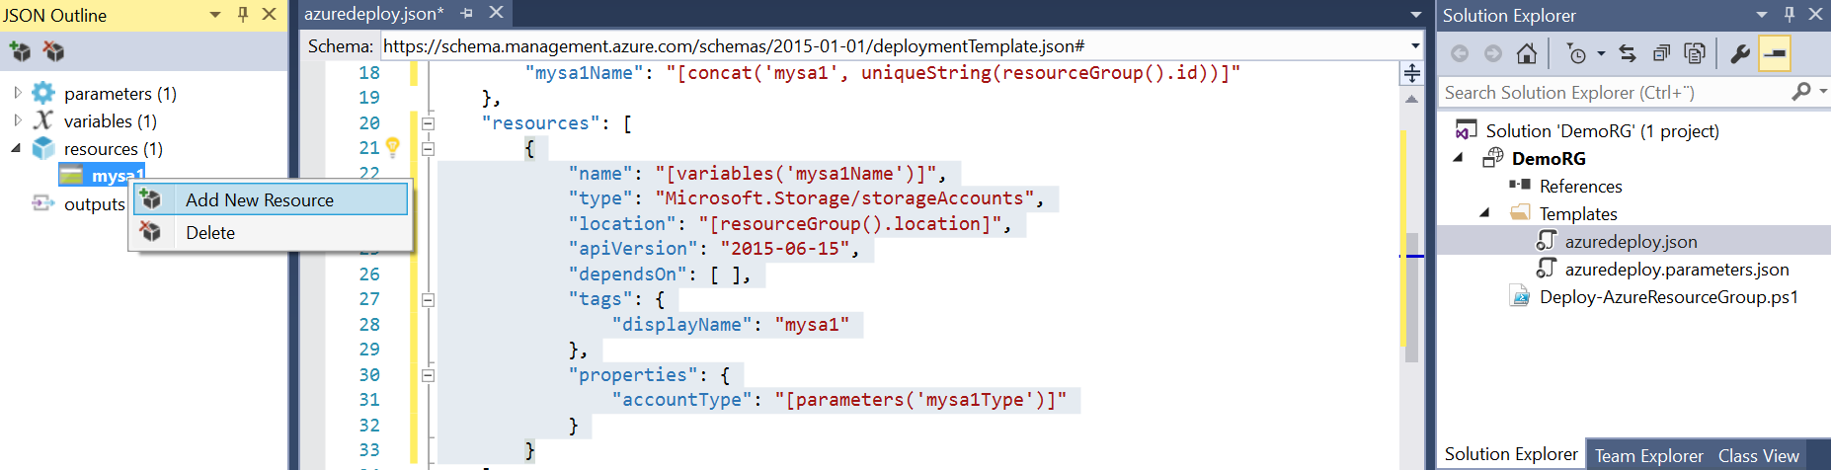
Visual Studio
Very popular
14 predefined ARM templates
Add resource, auto populates JSON tags
Notes:
You’re able to view and edit the .json, .parameters.json and the PowerShell deployment script from a central location.
This is very useful during the template authoring phase.
Can make local https://azure.microsoft.com/en-us/resources/templates/ Repository (which syncs to GitHub). So another ~501 templates (as at 9 March 2017 ).

Slide 59
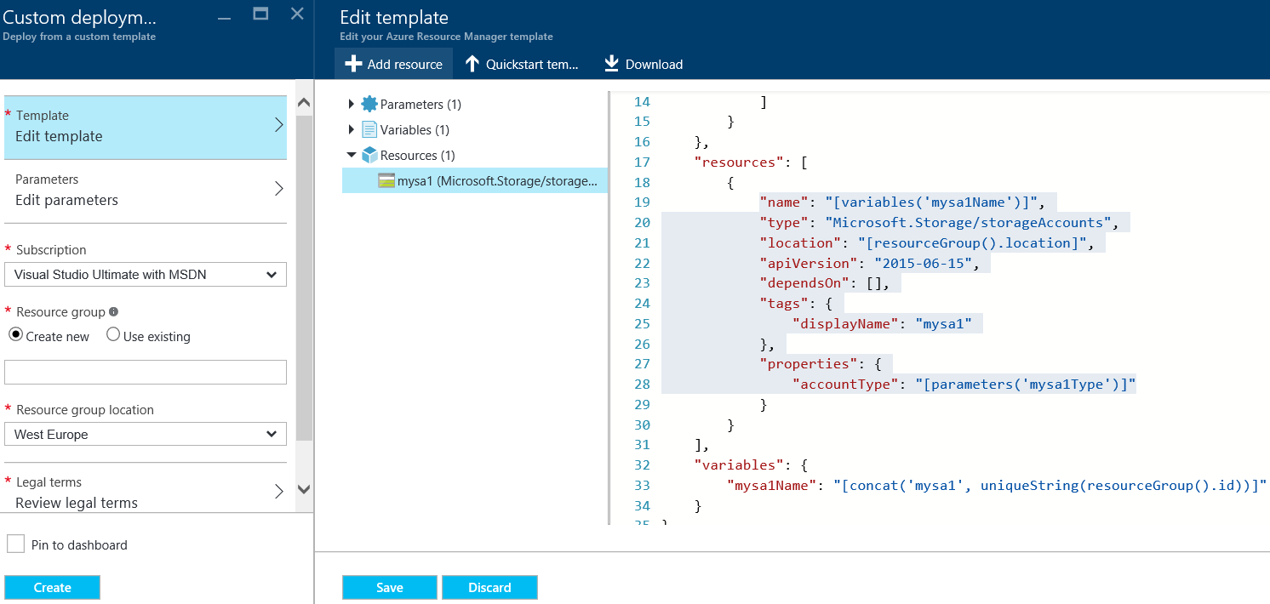
Azure Portal
Direct access to GitHub Gallery (has hundreds ARM Templates)
Template parameters can be specified using text boxes
Notes:
Like Visual Studio, the new Azure portal also automatically populates the JSON tags in your template when resources are added.

Slide 60
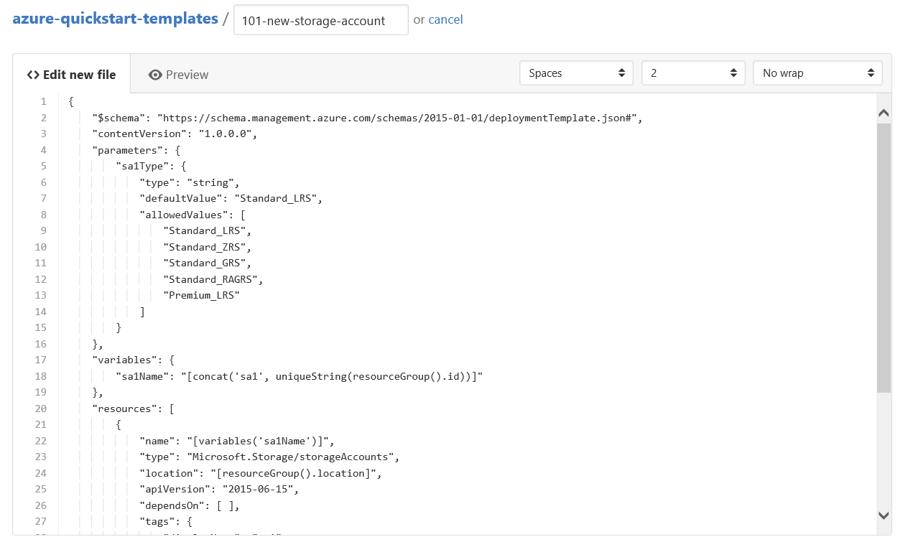
GitHub
Direct access to GitHub Gallery (has hundreds ARM Templates)
No built in syntax error checking or template validation during authoring
Notes:
GitHub. GitHub is a community driven portal that provides access to hundreds of predefined ARM templates that other members of the community have created. The contents of these templates can be copied and used as a starting point for a new template file. GitHub has no built in syntax error checking or template validation during authoring. These features must be built separately.

Slide 61

Lab: Explore Azure Cloud Tools
This lab aims to explore Azure Management Portal and Azure Tools.

Slide 62
Lesson Knowledge Check
Explain the basic model offerings of Microsoft Cloud
Explain the basic Azure Tools
What are the Azure Solutions available on Azure Portal for Intelligence + Analytics? Explain briefly
Notes:
Question 1 Answer:
IaaS
IaaS is fundamentally on-demand computing and storage to host, scale, and manage applications and services on-premise of with a dedicated hoster. The customer is still responsible for managing the OS through the Applications.
PaaS
With Platform as a Service, everything from the network connectivity through the runtime is provided and managed by the platform vendor.
The Windows Azure best fits in this category today.
SaaS
Finally, with SaaS, a vendor provides the application and abstracts you from all of the underlying components.
Question 2 Answer:
Microsoft Azure Storage Explorer
Utility for viewing and acting on Windows Azure Storage (non-database storage in the form of blobs, queues, and tables)
Azure Powershell
Azure PowerShell is a set of modules that provide cmdlets to manage Azure with Windows PowerShell.
Azure Command-Line Interface (Azure CLI)
set of open-source shell-based commands for creating and managing resources in Microsoft Azure.
Question 3 Answer:
Design and publish predictive models with Azure Machine Learning
Use Azure HDInsight to analyze data in Storm and Spark for Hadoop environments, integrate your code from R or Python
Analyze any kind or any size of data you need with Azure Data Lake Analytics

Slide 63
References
Microsoft Azure Storage
https://msdn.microsoft.com/en-us/library/azure/gg433040.aspx
Introducing Microsoft Azure
http://azure.microsoft.com/en-gb/documentation/articles/fundamentals-introduction-to-azure/#components
Azure Storage Scalability and Performance Targets
http://azure.microsoft.com/en-us/documentation/articles/storage-scalability-targets/
Notes:
Question 1 Answer:
IaaS
IaaS is fundamentally on-demand computing and storage to host, scale, and manage applications and services on-premise of with a dedicated hoster. The customer is still responsible for managing the OS through the Applications.
PaaS
With Platform as a Service, everything from the network connectivity through the runtime is provided and managed by the platform vendor.
The Windows Azure best fits in this category today.
SaaS
Finally, with SaaS, a vendor provides the application and abstracts you from all of the underlying components.
Question 2 Answer:
Microsoft Azure Storage Explorer
Utility for viewing and acting on Windows Azure Storage (non-database storage in the form of blobs, queues, and tables)
Azure Powershell
Azure PowerShell is a set of modules that provide cmdlets to manage Azure with Windows PowerShell.
Azure Command-Line Interface (Azure CLI)
set of open-source shell-based commands for creating and managing resources in Microsoft Azure.
Question 3 Answer:
Design and publish predictive models with Azure Machine Learning
Use Azure HDInsight to analyze data in Storm and Spark for Hadoop environments, integrate your code from R or Python
Analyze any kind or any size of data you need with Azure Data Lake Analytics

